Slide 1

Umesh Mahajan
Customer Retention Case Study
Internship batch : 32

Slide 2


Slide 3

What is Customer Retention and do we really need it?
“Customer retention refers to company’s ability to turn customers into repeat buyers and prevent them from switching to a competitor”
In other words customer retention means – “To maintain the existing customers”
This happens only if there exists a positive relation between the company and the customer.

Slide 4
What are the benefits of Customer Retention ?
Retained customers tend to buy other services from same company.
Retained customers are known to be less price/cost sensitive
The probability of selling to an existing customer is 60-70%
The probability of selling to new prospect is 5-20%
Declined migration rates
It’s more expensive to acquire a new customer than to retain an old one.

Slide 5
Problem Statement.
Customer satisfaction has emerged as one of the most important factors that guarantee the success of online store, it has been posited as a key stimulant of purchase or repurchase intentions and customer loyalty.
A comprehensive review of the literature, theories and models have been carried out to propose the models for customer activation and customer retention.
Five major factors that contributed to the success of an e-commerce store have been identified as: service quality, system quality, information quality, trust and net benefit.
The research furthermore investigated the factors that influence the online customers repeat purchase intention.
The combination of both utilitarian value and hedonistic values are needed to affect the repeat purchase intention (loyalty) positively.
The data is collected from the Indian online shoppers. Results indicate the e-retail success factors, which are very much critical for customer satisfaction.

Slide 6
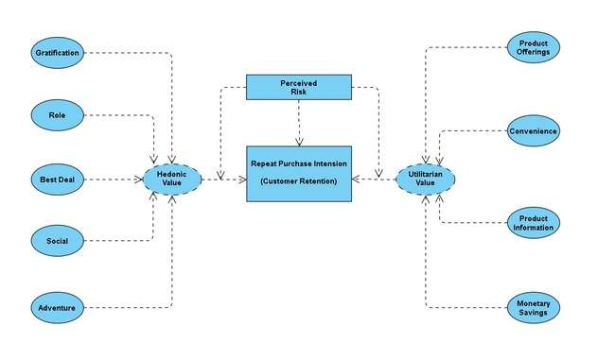
The problem statement can be represented in the form of below use case diagram as well.

Slide 7
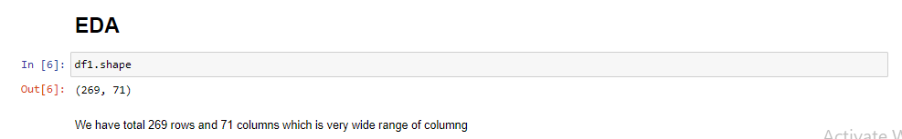
We are checking how much rows and columns we have in data set
We have 269 rows
We have 71 columns

Slide 8
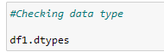
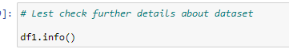
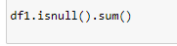

I found below point using codes mentioned on This slide
All are Object except “pin code”
Dataset taking 149 KB memory
No Missing data
Uniqueness is present in data

Slide 9





Dataset Information
Dataset contains top retail online stores
Questions are being asked to understand buying patter of consumers and their comfortless with site
We have tried to collect every possible data form customers so that we can improve

Slide 10
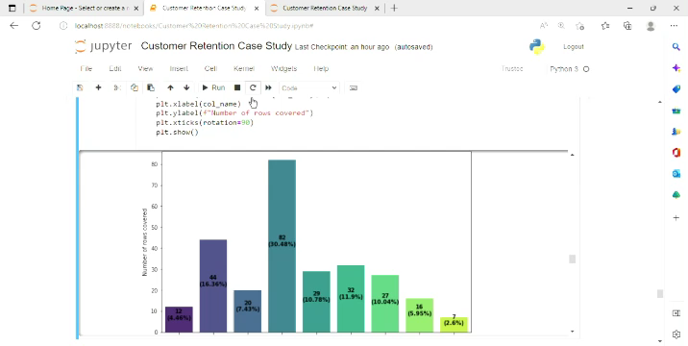

Slide 11
Important observation from slide no 10
Most of the consumers belong to Female category.
Highest buying category of age is 31 to 40 age of consumers.
Most of product are bought through Mobile internet .
Most selling product is smartphones.
Many consumer agree that loading speeding Is good that means delivery is fats.
70 % consumer agree that there is user friendly interface
Consumers believe that there is 68 % Privacy guarantee

Slide 12
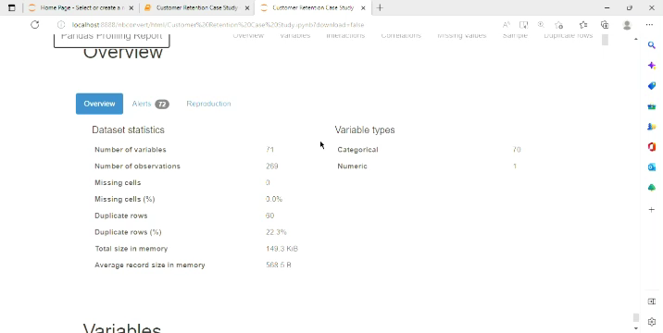
Trying to collect more information from below profiling

Slide 13

Observation for Amazon
Good points : -
Product variety is high at amazon
Visuals are also good
Fast Loading speed
Reliable website
Improvement : -
Deal with more bank and provide more discount.
Need to focus on rural area
Reduce delivery defection

Slide 14

Observation for Flipkart
Good points : -
Fast Delivery
Good Interface
Good lading speed
Improvement : -
Can give more payment option
Promote more on social media

Slide 15

Observation for Paytm.com
Good points : -
1. Convenient to use and a good website.
2. Quickness to complete a purchase.
3. About 64% of the customers feel that either web or app is reliable.
4. Around 20% of the customers believe that Paytm has a wild variety of products on offer.
Improvement : -
1. Reduce the delivery time of the products during promotions.
2. Try to give the price early during promotion.
3. During promotions, try to give a disturbance free shopping experience to customers.
4. Late declaration of price and discounts.
5. Frequent disturbance is occurring while moving from one page to another.
Online Store Company:

Slide 16
Observation for Myntra.com
Good points : -
1. Convenient to use and also a good website.
2. Availability of several payment options.
3. Faster products delivery.
4. Complete information of products available.
5. Reliable website or app, perceived trustworthiness.
6. Wild variety of product to offer
Improvement : -
Late price Declare needs to be improved
1. During promotions, try to give a disturbance free shopping experience to customers.
2. Try to give the price early during promotions.
3. Reduce the delivery time of the products during promotions.
Online Store Company:

Slide 17
Thank You

